Slide 1
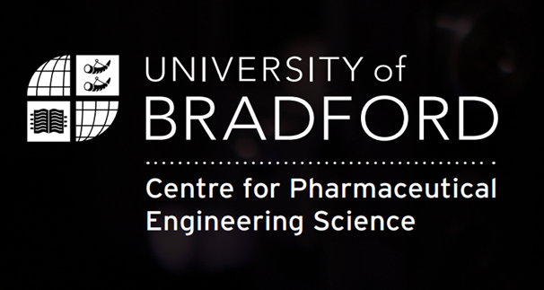
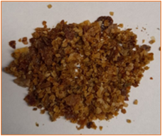
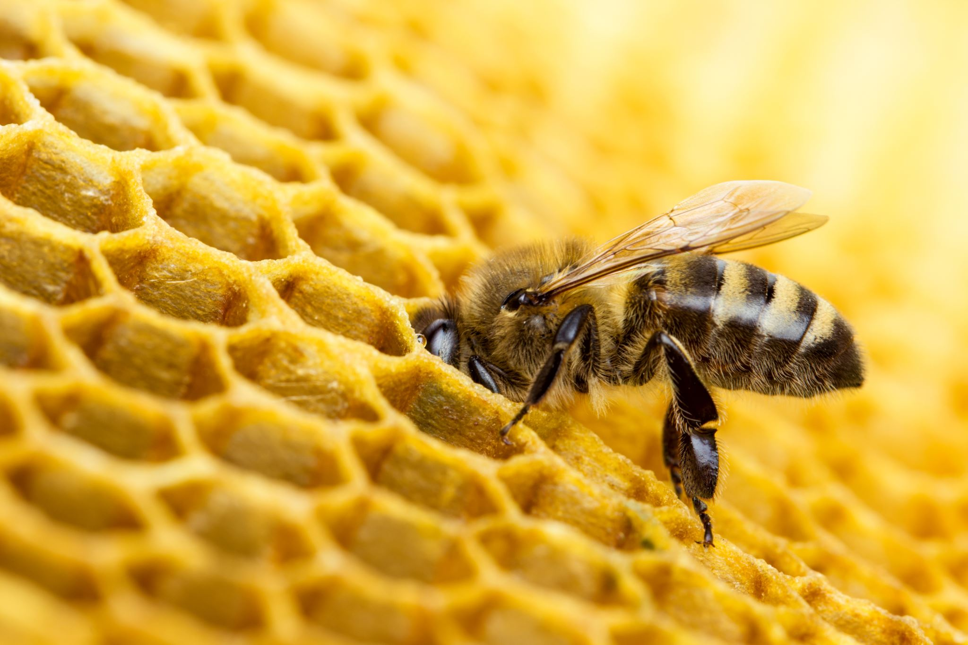
Preliminary Screening Of Raw Propolis Sample As Pre-formulation Study For Topical Preparations
Life Sciences PGR Conference 2024
Presented by: Ghaida Mustafa
PhD researcher, CPES, University of Bradford, UK
Supervisors: Prof. Anant Paradkar, Dr. David Ansel and Dr. Shahzeb Khan

Slide 2
Contents
Life Sciences PGR Conference 2024
Background.
Aim of the study.
Method.
Results and discussion.
Conclusion.
Acknowledgment.
References.

Slide 3

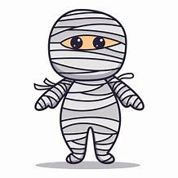


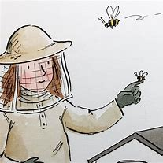
Beautification
Mummification
Glue
Sealer

Slide 4
Background
Life Sciences PGR Conference 2024
Propolis is a natural bee haemostat.
Numerous biological activities.
Phenolic acids and flavonoids.
Chemical composition variation.

Slide 5
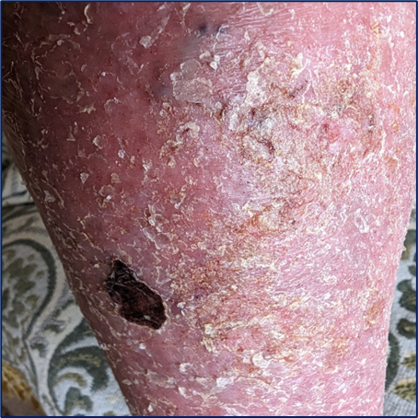

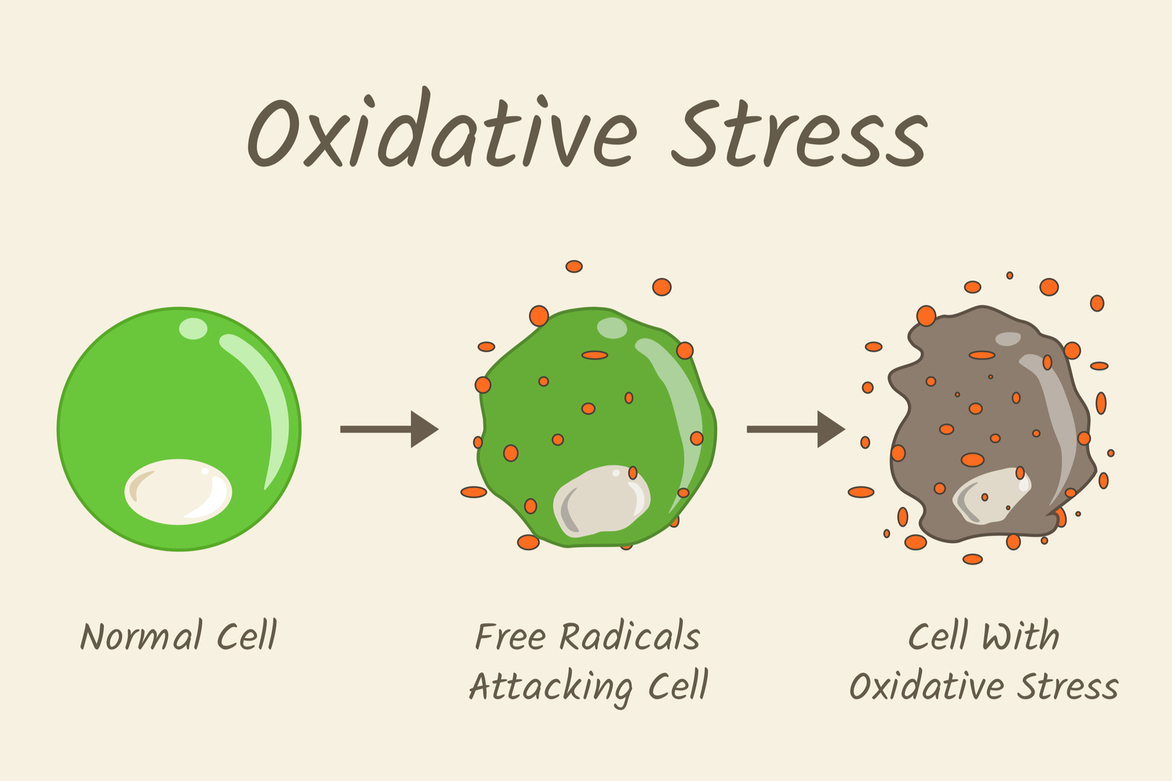
Life Sciences PGR Conference 2024
Propolis with valuable Biological activities on Skin
Wound healing
UV absorption
Antiaging

Slide 6
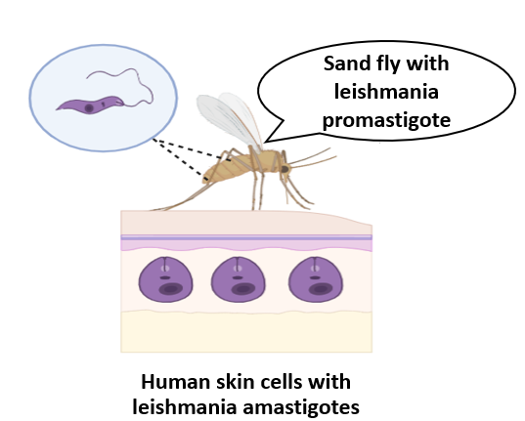
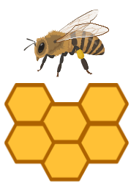

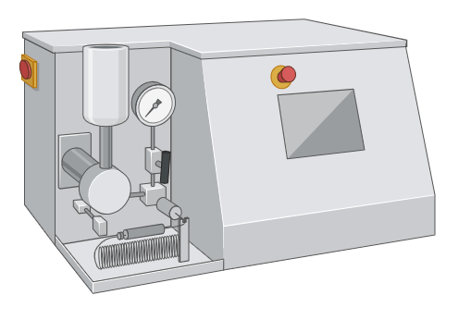

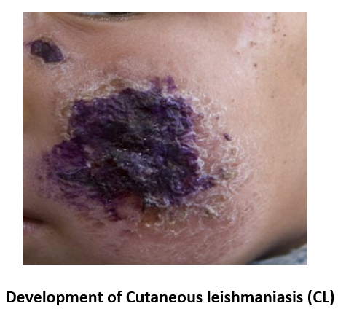
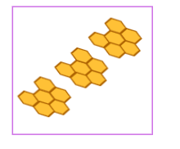


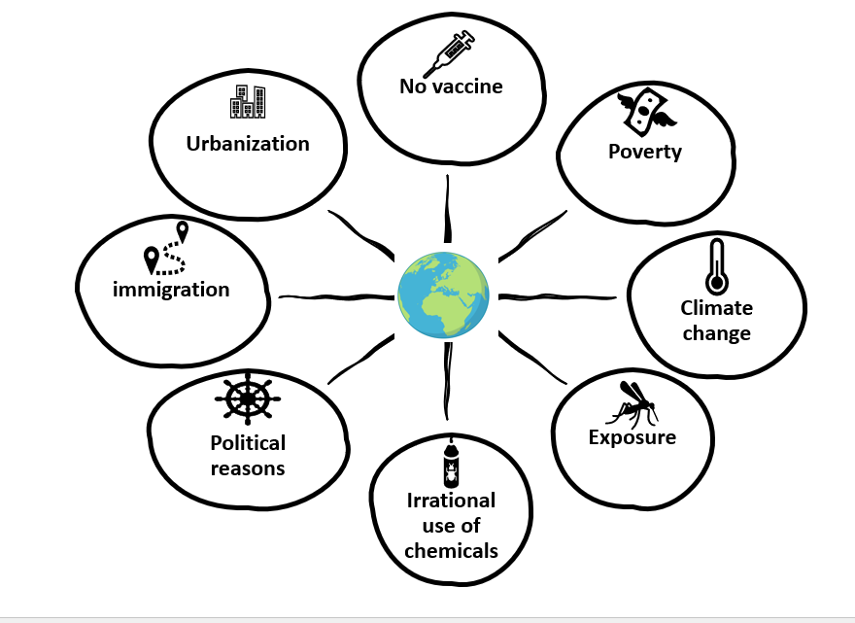
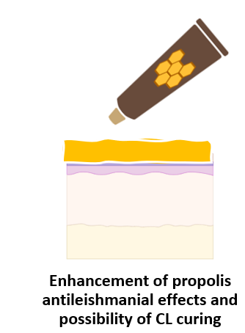
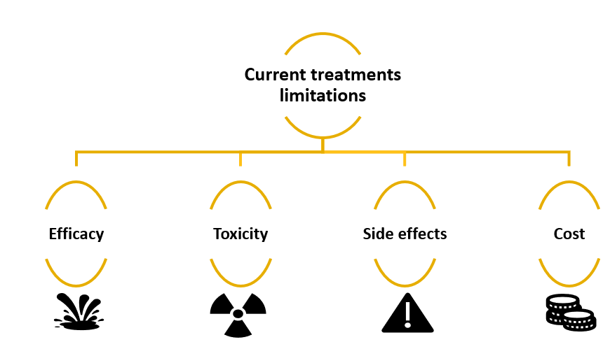


https://www.who.int/health-topics/leishmaniasis#tab=tab_1 https://doi.org/10.1007/s00436-008-0970-z
‘’Greater imitator’’
~ 1 million new cases & 30,000 deaths /year.
Propolis
Propolis nano formulations
Topical application

Slide 7
Aim of the study
Life Sciences PGR Conference 2024
To analyse raw propolis sample from India as topical preparations pre-formulation assay using Thermal gravimetric analysis (TGA), Fourier Transform Infrared (FTIR) and Reverse phase high performance chromatography (RP-HPLC).

Slide 8
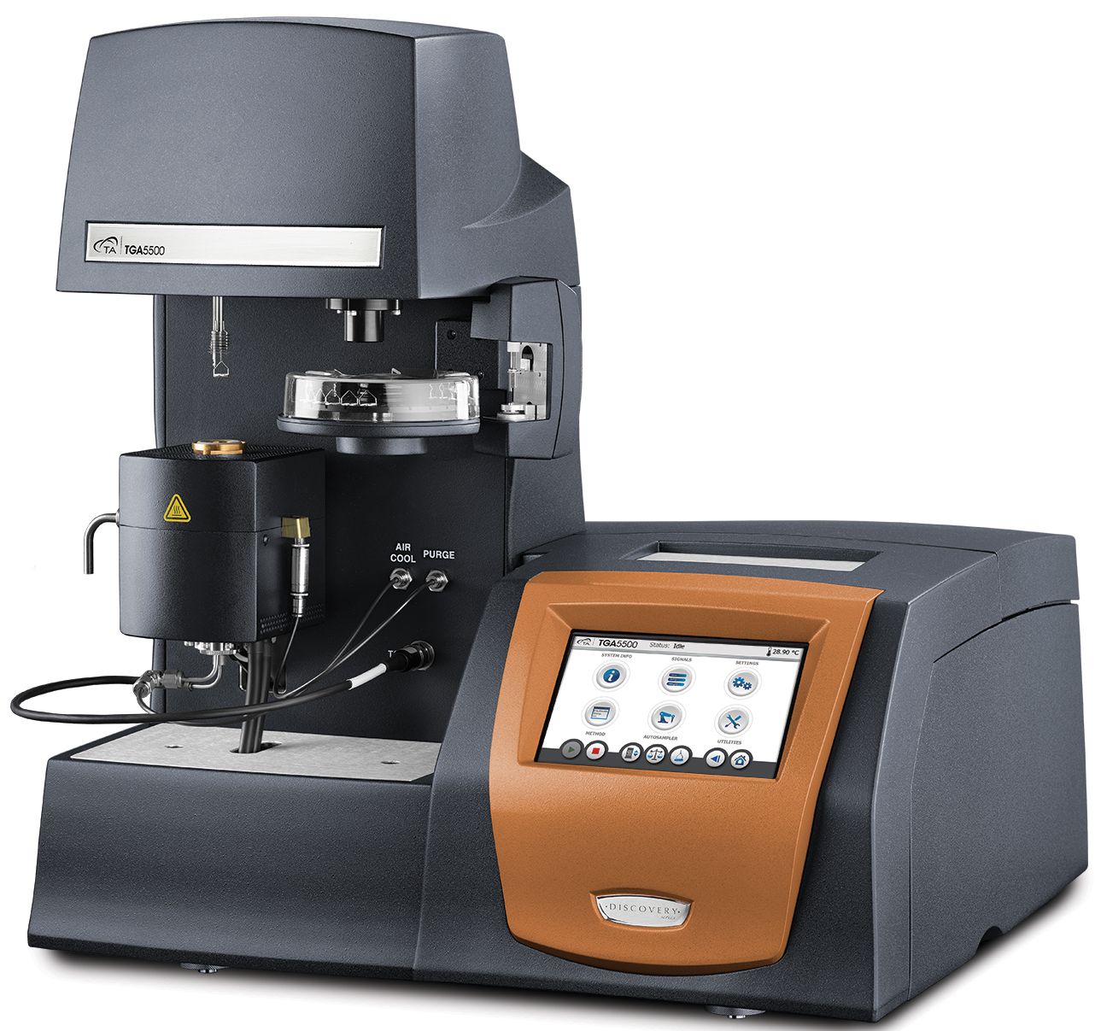
Method
Life Sciences PGR Conference 2024
TGA:
Heating program: in the presence of air at flow rate of 25 ml/min from room temperature to 105 °C at 10 °C/min, isothermal for 30 min. Heating at 10 °C/min to 550 °C, holding temperature for 30 min.

Slide 9
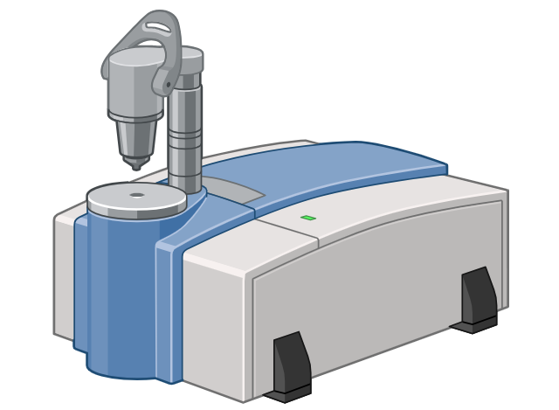
Method
Life Sciences PGR Conference 2024
2. FTIR:
Measurement: PerkinElmer Frontier FT-IR spectrometer.
64 Scans were performed from 4000-650cm-1.

Slide 10
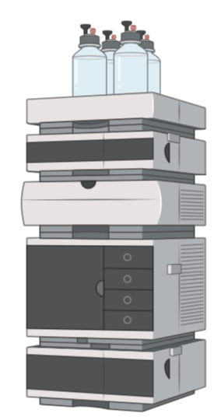
Method
Life Sciences PGR Conference 2024
3. RP-HPLC:
HPLC system: Waters e2695 separation module Waters 2998 Photo diode array (PDA) detector and Empower software Application.
Column: Waters Symmetry 300 TM, C18 (250x4.6 mm, i.d., 5µm).
Gradient mobile phases: 0.1% formic acid (solvent A) and methanol (solvent B) at a flow rate 1ml/min and 10 minutes condition column between the runs.
The chromatograms were collected at 290 nm.

Slide 11
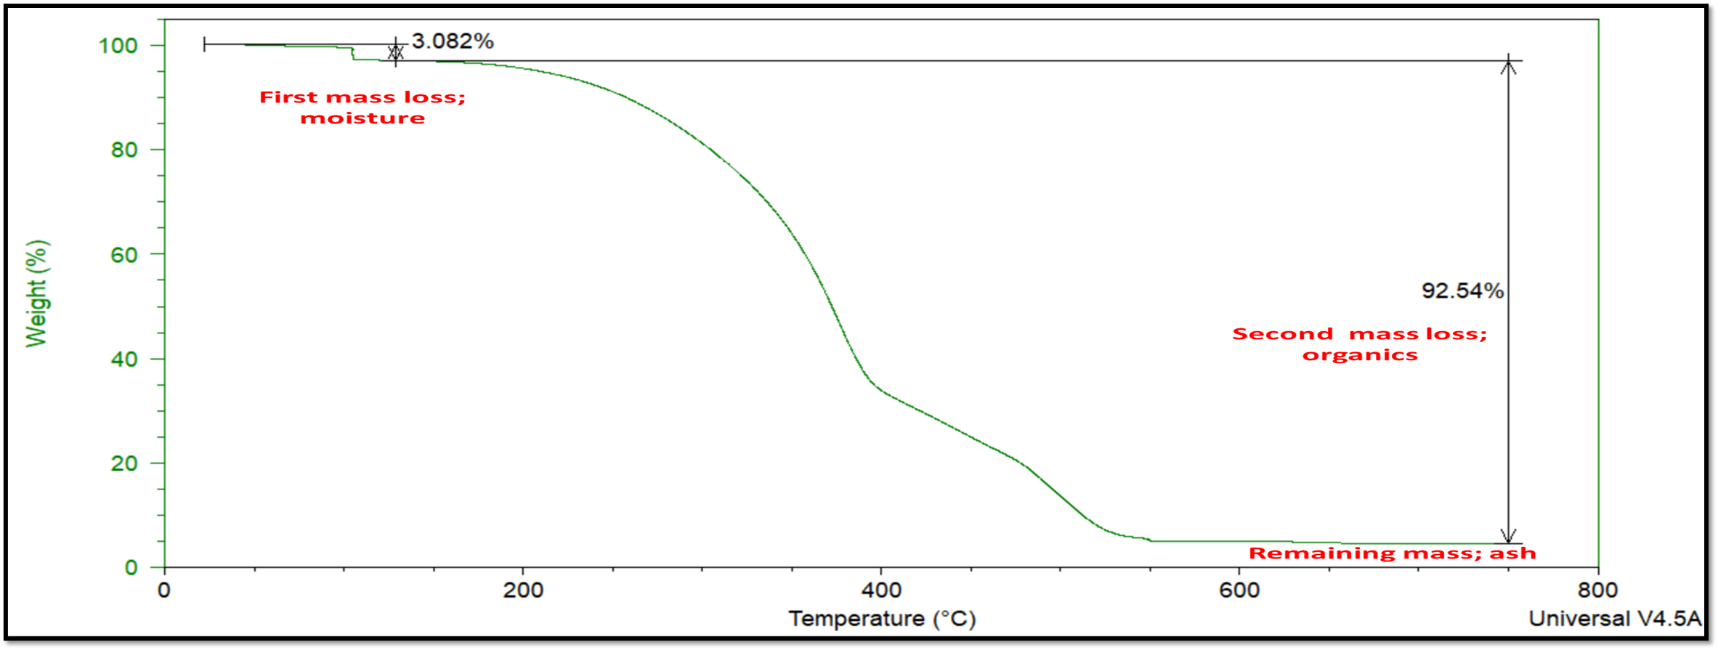
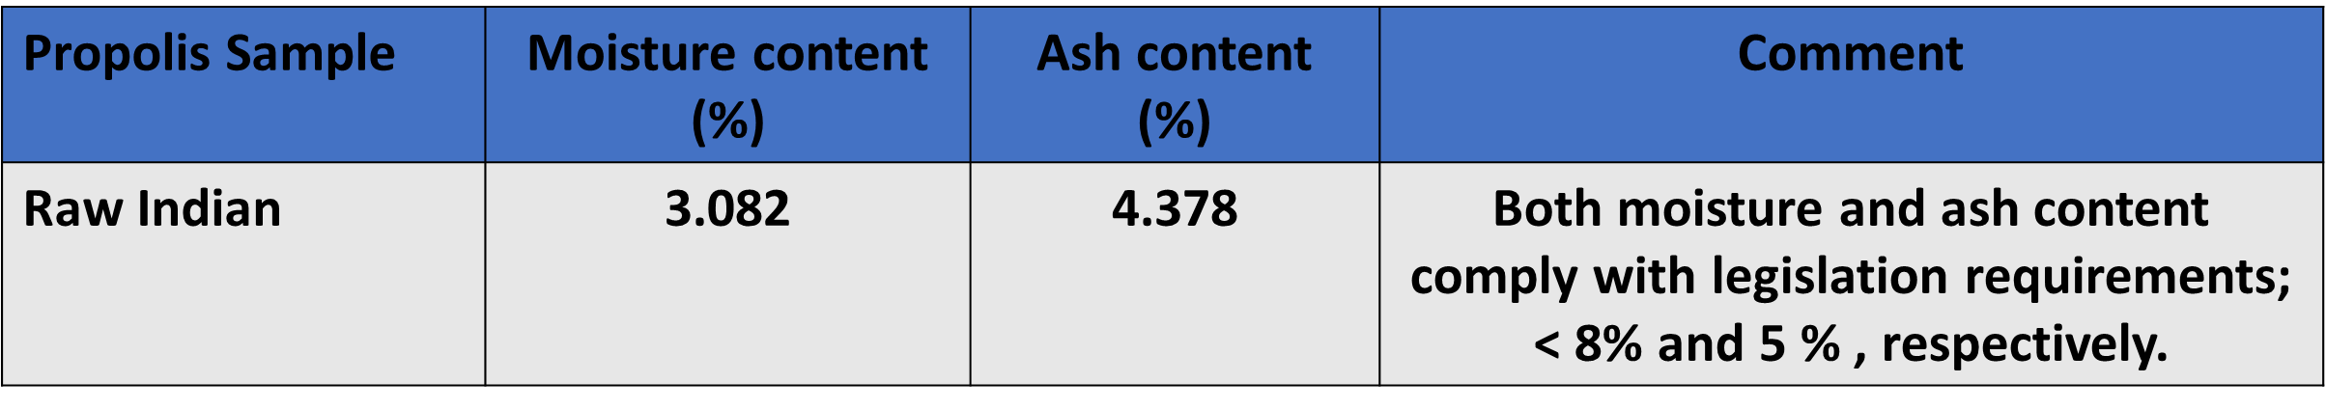
Results
Life Sciences PGR Conference 2024
1. TGA:

Slide 12
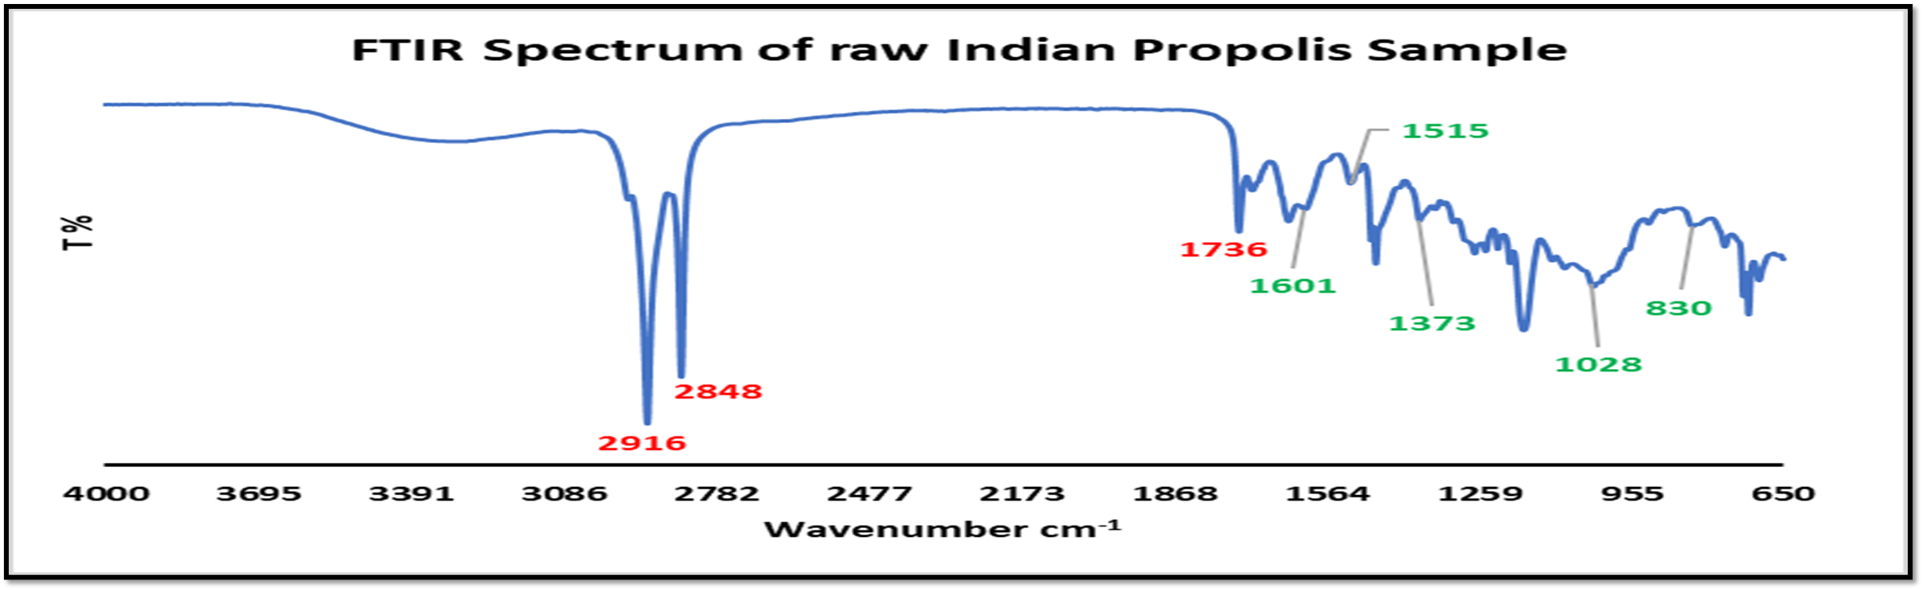
Results
Life Sciences PGR Conference 2024
2. FTIR:
FTIR spectrum of raw Indian propolis sample showing bands related to wax (red colour) and phenolics compounds (green colour).

Slide 13
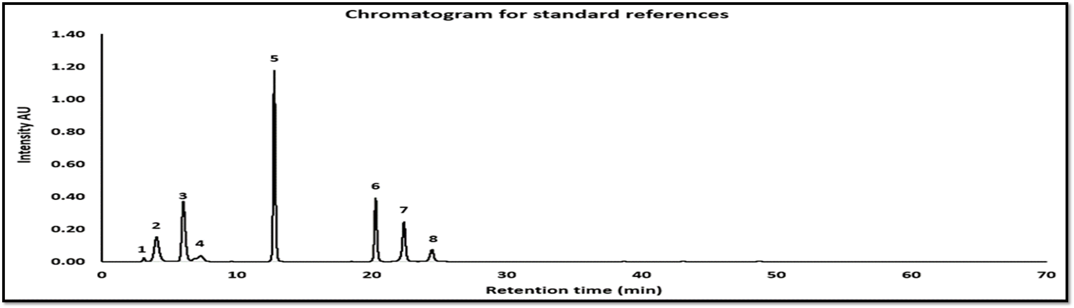
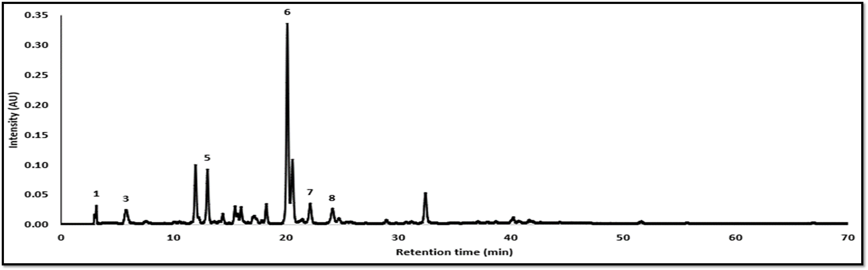
Results
Life Sciences PGR Conference 2024
3. RP-HPLC:
Chromatogram for standard references: 1. Chlorogenic acid, 2. Caffeic acid, 3. Ferulic acid, 4. Rutein, 5. Cinnamic acid, 6. Pinocembrin, 7. Chrysin, and 8. Galangin.
Chromatogram of raw Indian propolis sample: 1. Chlorogenic acid, 3. Ferulic acid, 5. Cinnamic acid, 6. Pinocembrin, 7. Chrysin, and 8. Galangin.

Slide 14



Conclusion
Life Sciences PGR Conference 2024
Data from the current study will provide a standardized profile of the analysed raw propolis samples, offer an initial guidance in the rational selection of the propolis formulation technique and allow the monitoring of the desired compounds for topical formulations.
Propolis topical preparations

Slide 15

Acknowledgment
Life Sciences PGR Conference 2024

Slide 16
References
Life Sciences PGR Conference 2024
Herrera-López MG, Richomme P, Peña-Rodríguez LM, Calvo-Irabien LM. Bee species, botanical sources and the chemical composition of propolis from Yucatan, Mexico. Journal of Chemical Ecology. 2023 Aug;49(7):408-17.
Bensharada M, Telford R, Stern B, Gaffney V. Loss on ignition vs. thermogravimetric analysis: A comparative study to determine organic matter and carbonate content in sediments. Journal of Paleolimnology. 2022 Feb 1:1-7.
Miłek M, Ciszkowicz E, Zaguła G, Grabek-Lejko D, Pasternakiewicz A, Lecka-Szlachta K, Dżugan M. Quality of Propolis Commercially Available on Podkarpacki Beekeeping Market. Journal of Apicultural Science.
Touzani S, Imtara H, Katekhaye S, Mechchate H, Ouassou H, Alqahtani AS, Noman OM, Nasr FA, Fearnley H, Fearnley J, Paradkar A. Determination of phenolic compounds in various propolis samples collected from an African and an Asian region and their impact on antioxidant and antibacterial activities. Molecules. 2021 Jul 29;26(15):4589.

Slide 17

Thank you

